Slide 1
Image Super Resolution using Deep Convolutional Neural Networks
CNN
Rithvika Pervala
Shubham Gupta
Notes:
This is team SPECTRUM and we will be presenting on the topic Image Super Resolution using Deep Convolutional Neural Networks

Slide 2
Table of Contents
01
04
Methodology
Introduction and Objectives
Datasets Used
02
05
Results and Conclusion
Accuracy
Evaluation Metrics
Preprocessing Steps
03
06
Future Direction
Real-World use Cases
Comprehensive Error Analysis
Enhance 2D CNN
Diverse Datasets
Models Available
Model Chosen
Architecture of the Model
Objective Achieved
BSDS 500
Set 4 and Set 15
BSDS 200
YCbCR Color Spacing
Distortion
Bicubic Interpolation (Upscaling)
Normalization and Data Loading

Slide 3

Introduction
Super Resolution (SR)
Computer Vision Problem - Aims at recovering a high-resolution image from a single low resolution image.
Use cases
Old Images - Vintage, CCTV footage
Denoising - Low Light, Rain, Snow, High Sunlight Intensity
Algorithm Types
Patch/Example based methods - State of the Art
Prediction models
Edge based methods
Image statistical methods
Notes:
The problem of Super-Resolution (SR) is a classical computer vision problem that aims at generating High Resolution image from Low Resolution Image
Use cases:
Applied in situations bound my technical/natural limitations such as old images or CCTV footage in factories where weather conditions lead to blurry images that require denoising and SR for study.
Algorithm Types
Patch Example Based
They learn using internal (image that we want to resolve) or external (images that are used externally to learn information - not the one that is desired to be resolved) example patches and find mapping between low and high resolution patches. These give state of the art performance.
Sparse Coding and the model we are going tol are examples of this method
Prediction Models
Generate HR images from LR inputs through a predefined mathematical formula without training data.
Interpolation-based methods like bilinear, bicubic, and Lanczos Interpolations are examples of this method
They generate HR pixel intensities by weighted averaging neighboring LR pixel values
Edge Based Methods
They learn information from the edge features of images for reconstructing HR images.
Depth and width manipulation of an edge, or gradient profile method are some of the examples
The HR images have high-quality edges with proper sharpness and limited artifacts.
Less effective at high-frequency structures such as textures
Image Statistical Methods
Various image properties can be exploited to predict HR images from LR images.
The heavy-tailed gradient distribution,sparsity property of large gradients are some such properties that are exploited

Slide 4
Objectives
Demonstrate that deep learning is useful in the classical computer vision problem of superresolution, and can achieve good quality and speed.
Build a CNN (preferred 3 layered) that incorporates all the functionalities in the form of end-to-end mapping:
Feature extraction
Resolution enhancement
Classification
Error analysis.
Notes:
Demonstrate that deep learning is useful in the classical computer vision problem of superresolution, and can achieve good quality and speed.
Build a CNN (preferred 3 layered) that incorporates all the functionalities in the form of end-to-end mapping:
Feature extraction
Resolution enhancement
Classification
Error analysis.

Slide 5
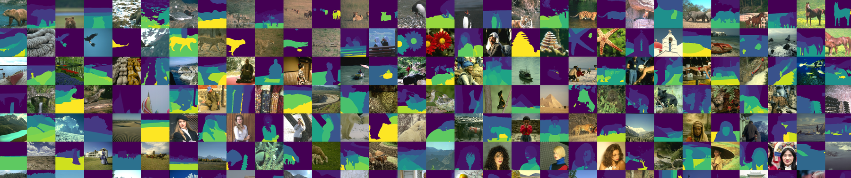
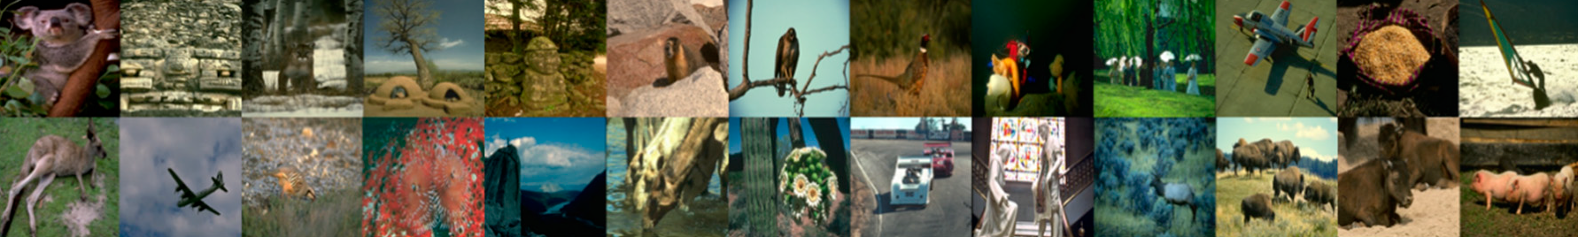
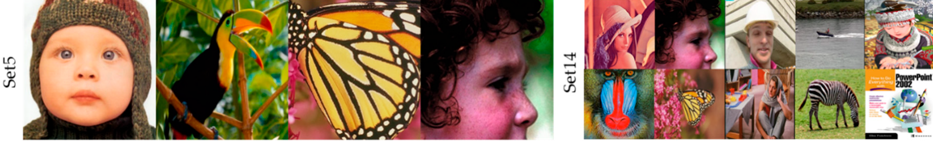
Datasets Used
BSDS500
BSDS200
Set 5 and 14
Training, Testing and Validation Set
Evaluation Set
Evaluation Set
Notes:
Why these Datasets?
SRCNN Requires diverse data spanning a multitude of colors generally high contrasting to distinguish between features easily
Berkeley Segmentation Dataset 500
The dataset consists of 500 natural images, ground-truth human annotations and benchmarking code. Each image was segmented by five different subjects on average. BSDS200 is an older version of BSDS 500 comprising of less and old images.
Set 5 and 14
Set 5 (Consisting of 5 images) and Set 14 (Consisting of 14 images) is a standard dataset to evaluate the performance of super resolution of images.
Training - BSDS Train and Test Dataset
Validation - BSDS Validation Dataset
Evaluation - BSDS 200, Set 5 and Set 14
It is used for the purpose of prediction and gives a comprehensive analysis about the performance of ML model with respect to real world data

Slide 6
Pre-Processing
Applied for Ground Truth Train, Test, Validation Sets of BSDS 500:
Image Cropping - 480 x 320 320 x 320
Extracting patches of 32 x 32 from the square image
colour spacing
Converge each image into a NumPy Square Matrix and store them in YCbCr colour spacing.
Distortion
Filtering colour channels
Applying Gaussian filter for blurring
Upscaling by bicubic interpolation - 32 x 32 size matrix
Normalization
Tensor Loading
Notes:
Crop the image into standard size and extract patches of 1024 (matrix size of 32 * 32) pixels making it easy to pre-process and carry out the encoding
Converge each image into a NumPy Square Matrix and store them in YCbCr colour spacing.
We distort of Images is done by first separating the colour channels and
applying distortion in Y (luminance) colour channel with the help of the custom function distort_image() using a blurring
factor SIGMA for Gaussian Blurring done by applying a Gaussian filter
Upscaling - The Low-resolution distorted Image is then upscaled to same size (32 * 32) as Ground Truth using
bicubic interpolation and Super Resolution Factor
Normalization - Subtraction of Mean followed by division by Standard Deviation of the training data set
After this a Tensor is created out of the pre-processed image which is then ready for loading into the model
https://en.wikipedia.org/wiki/YCbCr
https://en.wikipedia.org/wiki/Gaussian_filter
https://en.wikipedia.org/wiki/Bicubic_interpolation

Slide 7
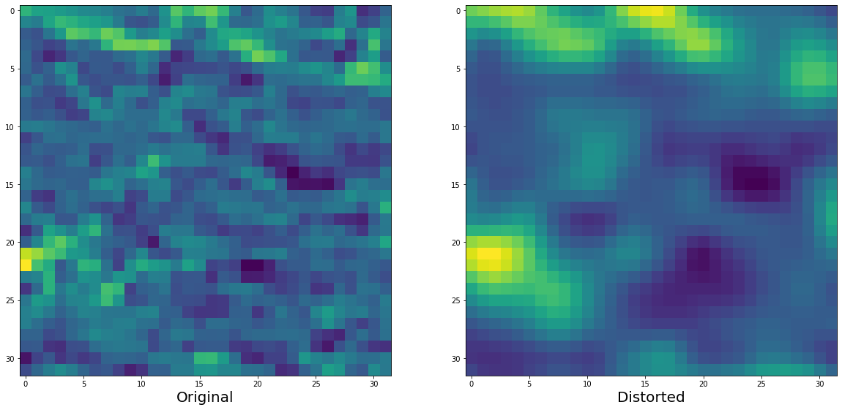
Original Patch VS Distorted-Upscaled Patch
Notes:
We can see the contrast of images. Original images vs distorted images which were created after applying the Gaussian Filter for blurring by the specified factor

Slide 8
Methodology
MODELS AVAILABLE
MODEL CHOSEN
ARCHITECTURE OF MODEL
MODEL TRAINING
Notes:
Now we will move onto the methodology of the project

Slide 9
Available Models
Example based
Internal representation
Learns by Epitome matching
Old: Multi-exposure image noise reduction, Single-frame deblurring, Sub-pixel image localization
New: Local Self-Example based SR
External representation
Learns by a wide variety of methods such as SC/NE + LLE/ANR/A+/KK
All models that use CNNs
EDSR SRCNN ESPCN FSRCNN LapSRN
Hybrid/Joint representation
Combines both internal and external to give enhanced results
Proposed Joint SR (JSR)
Notes:
We use example based models as the model learns by image examples. Classified as internal, external and joint.
Internal representations exploits internal similarities within the image and creates similarities between the noise and signals that lead to the decrease in resolution and uses this for SR purposes. They learn by Epitome matching.
https://en.wikipedia.org/wiki/Super-resolution_imaging
External representations create a mapping between the LR and HR images and tries to remove the noise by iteratively denoising and deblurring the image. They use a pair of images for training purposes (blurry, target). Learn by
SC - sparse coding-based method
NE+LLE - neighbour embedding + locally linear embedding method
ANR - Anchored Neighbourhood Regression method
etc
SRCNNs come under this category
Hybrid representation combines both internal and external representation to give best results by both internal and external SR.
-- NA --
Reference
A+ - Adjusted Anchored Neighbourhood Regression
method [42], and
KK - the method described in [25], which achieves
the best performance among external examplebased
methods, according to the comprehensive
evaluation conducted in Yang et al.’s work
https://towardsdatascience.com/deep-learning-based-super-resolution-with-opencv-4fd736678066
https://en.wikipedia.org/wiki/Sparse_dictionary_learning
https://arxiv.org/pdf/1503.01138.pdf
Functions from both of them are implemented to give best results

Slide 10
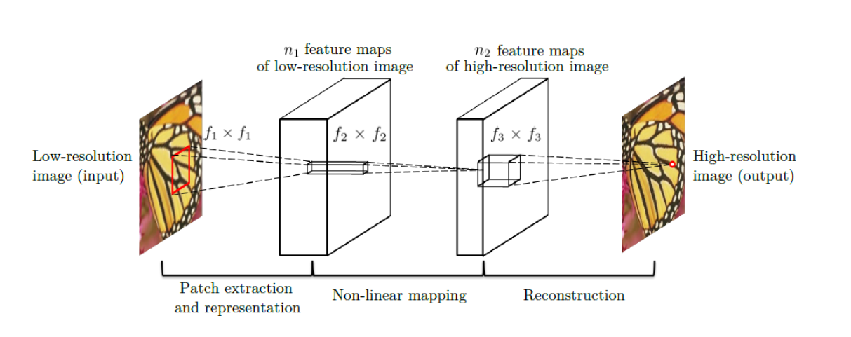
Chosen Model - SRCNN
External example-based SR methods
State of the art results (2015)
3 layered CNN
Fully Feed Forward
Representative - Minimal Pre and Post Processing
End-to-End Mapping
Notes:
SRCNN is a simple 3 Layer CNN which learns an end-to-end mapping from a bi-cubic interpolated low-resolution image to a high-resolution image.
Why this when recent Deep SR Methods are more powerful?
Since the advent of SR-CNN, a variety of CNN networks with deeper and denser network structure like have been like SRDenseNet (67 Conv 2 Deconv Layers), SR-ILLNN (15 Conv Layers 2 DeConv layers), SR-SLNN (7 Conv Layers 2 DeConv Layers) etc but they are much hard to implement, slow
Feed Forward
Unlike traditional Sparse coding methods which uses solvers that iteratively process each linear sparse patches in the mapping, the Non-Linear operator (ReLU and the first two layers) in our SRCNN is fully feed forward.
The Data is fully passed to the next layer with no return maximizing the information passage (representation) per pixel from every segment in the image
https://en.wikipedia.org/wiki/Feed_forward_(control)
Representation Learning (End-to-End)
They do the most of the pre-processing like patch extraction and aggregation is done in the SRCNN itself along with finding efficient mapping between the low-resolution dictionary, high-resolution dictionary
It also does mean subtraction and averaging via the filters and hence optimized.
So our method optimizes an end-to-end mapping that consists of all operations.

Slide 11
Model Architecture
Convolution Layer 1
Convolution Layer 2
Convolution Layer 3
Kernel Size - 9 x 9
Input Channels - 1
Output Channels - 64
Kernel Size - 1 x 1
Input Channels - 64
Output Channels - 32
32
32
64 Low Resolution Feature Maps
32 High Resolution Feature Maps
Kernel Size - 7 x 7
Input Channels - 32
Output Channels - 1
Notes:
We send a preprocessed Image patch of 32x32 into the first Conv layer. We send 216361 such patches for training
Layer 1
The layer is used for Patch Extraction which is done via convolving over the image by a set of 1 x 9 x 9 Filters (In channels x Kernel Size)
There is only one channel through which the Y Colour channel from the YCBCR Colour space is sent
It produces 64 - Dimensional Low Resolution Feature Maps which is pushed from the Out Chanel
ReLU activation is used to make it a non-linear convolution
2nd Layer
This layer is used for finding efficient non-linear mapping between the 64 Low Resolutions into 32 High Resolution Feature Maps which are pushed into the Out Channel
For non-linearity ReLU activation function is used.
We use this Kernel Size 1 x 1 as this would help us to compare with the Sparse Coding.
3rd Layer
The last layer reconstructs the output image from the 32 high resolution feature maps and pushes the image patch out of one channel
The high resolution image patch is 32 x 32
Why these Kernel Sizes?
The Filter 2 Fixed to 1 x `1 as that makes comparison to Sparse Coding Method Easier
However Increasing the 2nd Filter helps in utilizing more neighborhood information in the mapping stage hence higher performance (9 - 3 - 5 < 9 - 5 -5 )
However Deployment Speed drastically decreases as the number of parameters increases. Low speed for marginal performance increase
9-1-5 - 8,032
9-3-5 - 24,416
9-5-5 - 57,184 respectively.
The complexity of 9-5-5 is almost twice of 9-3-5,

Slide 12
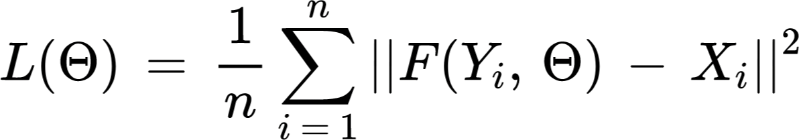
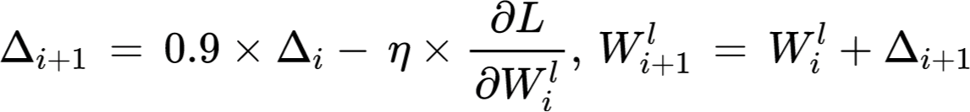
Training
Mean Squared Error Loss function
Optimized using SGD
No padding
Border effects are avoided
Arbitrary sized images
Notes:
The weights and biases of each layer are calculated through minimizing the loss between the reconstructed images F(Y) and the corresponding ground truth high resolution
images X. We use Mean Squared Error (MSE) as the loss function: (where n is the number of training samples)
Using MSE as the loss function favors a high PSNR (We will talk about PSNR later).
It is evaluated only on the difference between central pixels and network output
MSE is optimized using stochastic gradient descent with the standard backpropagation (8 * 10^8 for our model). The weight matrices are
updated using the given function
where, eta is the learning rate, and dL/dWi is the derivative.
The filter weights of each layer are initialized by drawing randomly from a Gaussian distribution with zero mean
and standard deviation 0.001 (and 0 for biases).
The learning rate is 10^(-4) for the first two layers, and 10^(-5) for the last layer. The learning rate is kept small for the last layer which allows it to converge.
To avoid border effects during training, all the convolutional layers have no padding, and the network produces a smaller output
Although we use a fixed image size in training, the CNN can be extended to arbitrary image sizes during testing

Slide 13

Results
LOSS PLOTS
EVALUATION METRICS
IMAGE COMPARISON
Notes:
Moving onto the results of the model

Slide 14
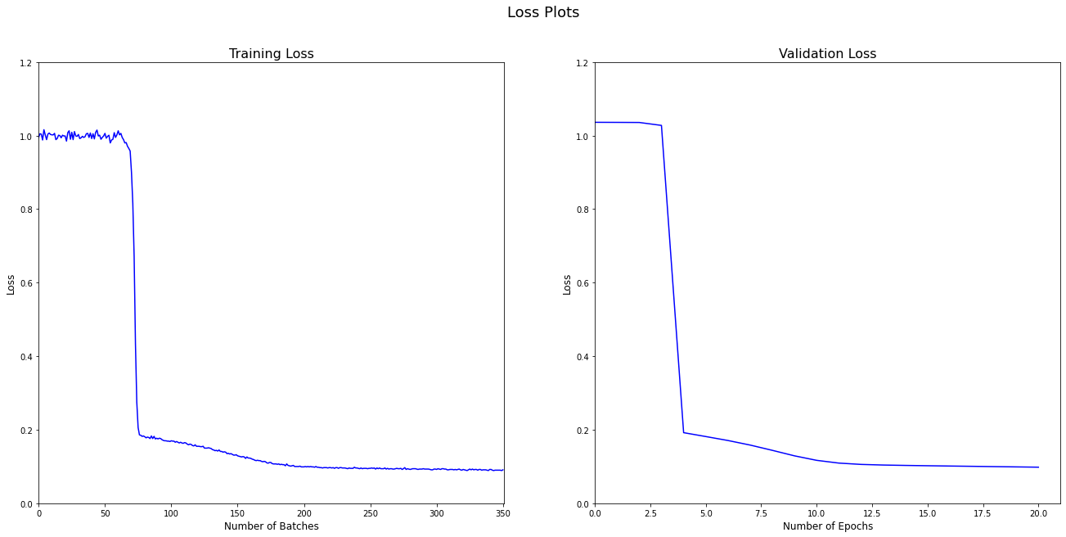
Accuracy - Loss Plots
Notes:
Given the resources and time at our hand, our model obtained a minimal validation loss of 0.099288. This can be optimized if run for a longer time.
Training loss - The loss across batches drops sharply after 75 batches that is after around 4-6 epochs
Validation Loss - Similar to training loss we see an abrupt drop in loss after 4-6 epochs, showing that the Model is picking up the intricacies in the form of better representations

Slide 15
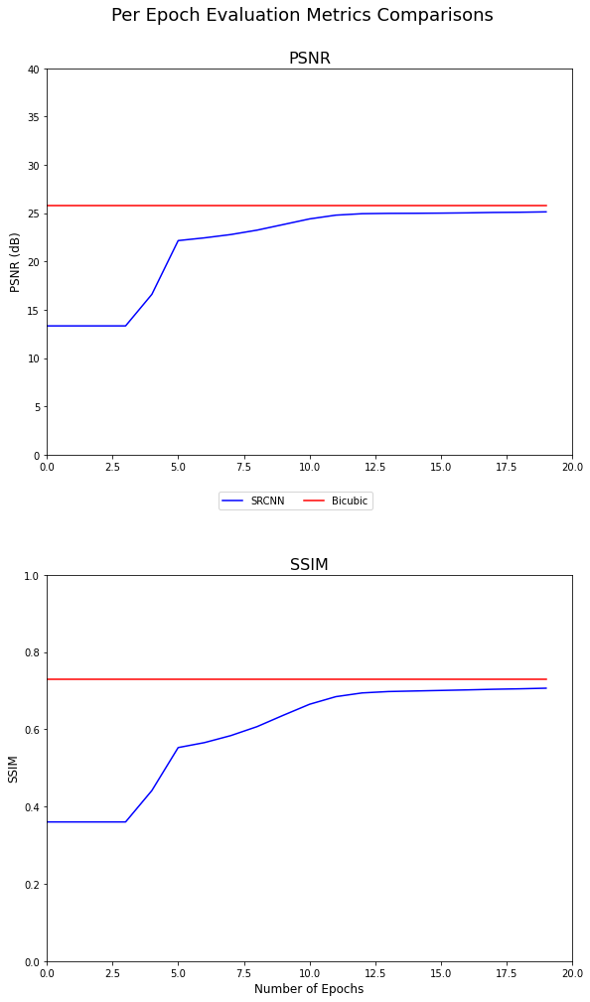
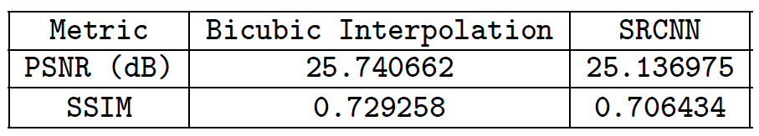
Evaluation Metrics
Notes:
PSNR (Peak Signal Noise Ratio)
PSNRis a widely used metric for quantitatively evaluating high restoration quality
Partially related to perceptual quality as well
PSNR is usually expressed as a logarithmic quantity using the decibel scale (dB).
MSEis known to favour High PSNR value
SSIM(Structural Similarity Index Measure)
SSIMis used to quantify Perceptual Quality - How humans perceive it.
It ranges between [0,1]
Although this metric better evaluated over MAE (Mean Absolute Error), MSE also gives satisfactory performance over SSIM.
Comparison
While the SRCNN still leads to lower PSNR and SSIM values for 20 epochs when compared to Bicubic, it will however surpass it after few more epochs as evident in the research paper and the below graph as well.

Slide 16
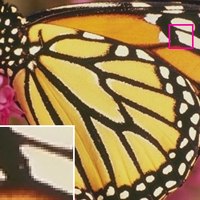


Image Contrast
Original
Bicubic
SRCNN
Notes:
We can see the images obtained after training by the SRCNN model and change in the resolution.
Once the bicubic interpolation benchmark is crossed we get images clearer than the original images after SR

Slide 17
Conclusion
Major deduction points from SRCNN model:
Representative external example-based SR model
Minimal pre/post processing
Enhancements for optimality:
Dataset addition -> Structure and functionality
Enhanced color space (YCbCr)
Luminance optimization
Y only
Multiple channel optimization in contrast with pre-training
Y pre-train, CbCr pre-train, YCbCr
Notes:
Combining multiple datasets for evaluation gives better model accuracy along with results more inclined towards practical applications
We have trained the model only for the Y Luminance channel. This can be extended to other channels such as Cb and Cr in the color space.
MSE can be employed on the CbCr color space also and merged with Y channel to fine tune all the parameters.
--NA--
The standard RGB color coding was replaced with an enhanced YCbCr
color coding which is the main image pipeline in video and digital
photography systems. Computers use this color space as it gives a more
vivid and contrasted-color image which is far more pleasing than the RGB
image.
Comparisons. We compare our method with the stateof-
art color SR method – KK [25]. We also try different
learning strategies for comparison:
Y only: this is our baseline method, which is a
single-channel (c = 1) network trained only on
the luminance channel. The Cb, Cr channels are
upscaled using bicubic interpolation.
YCbCr: training is performed on the three channels
of the YCbCr space.
Y pre-train: first, to guarantee the performance on
the Y channel, we only use the MSE of the Y channel
as the loss to pre-train the network. Then we employ
the MSE of all channels to fine-tune the parameters.
CbCr pre-train: we use the MSE of the Cb, Cr
channels as the loss to pre-train the network, then
fine-tune the parameters on all channels.
RGB: training is performed on the three channels of
the RGB space.
Backpropagation is the mechanism of changing the gradient descent (SGD in this case)
to obtain a better training. It is very commonly used in feed forward CNNs
The paper explicitly specifies that the number of backward propagation is 8 * 10^8
but the repository implements 15 * 10^6. Increasing back
propagations is not an performance optimization but trains the
model to capture the features better and increase the resolution in lower
epochs.
https://en.wikipedia.org/wiki/Backpropagation

Slide 18
Future Direction
Code Modularization
Comprehensive Error Analysis
Support for SSIM along with pre-existing PSNR
Add further functionality for IFC, NQM and other possible evaluation metrics.
Graph Plotting and Result Tabulation
Bicubic Interpolation benchmark
Clearer images than before
Take the scale from HD - 1080p to UHD - 1440p and 4K - 2160p
2-Dimensional CNN enhancement to support
Larger network width from 64 * 32 to 128 * 64 (Increase of the scale size by 4)
Diversify datasets to take into account more evaluation data
Kaggle - Gold Mine for SR datasets - https://www.kaggle.com/search?q=super+resolution
Diverse 2K - https://paperswithcode.com/dataset/div2k
Urban100 - https://paperswithcode.com/dataset/urban100
PIRM (Perceptual Image Restoration and Manipulation) - https://paperswithcode.com/dataset/pirm
Notes:
The next part of the project we seek to:
Build a comprehensive error analysis in consensus with each dataset. IFC, NQM and other evaluation metrics will be considered
for new evaluation data also
Diverse 2K, Urban100, PIRM contain a diverse classification of images which can be extended for the training and test dataset
Currently we have about total 700-800 images for the model, which can be taken to 3000+ images.
--NA--
https://paperswithcode.com/datasets?task=image-super-resolution
Kaggle is a gold mine for data
https://www.kaggle.com/ll01dm/set-5-14-super-resolution-dataset
Modularize the code as the code has a lot of blocks that are repeated, especially
in the Pre-processing part.
Given more resources , we will seek to enhance the to support
network width to 128 * 64 from width 64 * 32
This will enhance the to give superior performance even for lower
amount of epochs.

Slide 19
Q & Session
Q & A
Session
Notes:
We are now open to questions from the students as well as the faculty and instructors
Why this when recent Deep SR Methods are more powerful?
Since the advent of SR-CNN, a variety of CNN networks with deeper and denser network structure like have been like SRDenseNet (67 Conv 2 Deconv Layers), SR-ILLNN (15 Conv Layers 2 DeConv layers), SR-SLNN (7 Conv Layers 2 DeConv Layers) etc but they are much hard to implement, slow
Why these Kernel Sizes?
The Filter 2 Fixed to 1 x `1 as that makes comparison to Sparse Coding Method Easier
However Increasing the 2nd Filter helps in utilizing more neighborhood information in the mapping stage hence higher performance (9 - 3 - 5 < 9 - 5 -5 )
However Deployment Speed drastically decreases as the number of parameters increases. Low speed for marginal performance increase
9-1-5 - 8,032
9-3-5 - 24,416
9-5-5 - 57,184 respectively.
The complexity of 9-5-5 is almost twice of 9-3-5,
Why ony Y channel?
Our method is flexible to accept more channels without altering the learning mechanism and network design.
In particular, it can readily deal with three channels simultaneously by setting the input channels to c = 3.
However Performing on the Y channel leads to much better performance as it is the Luminance Channel
But also if we use Y pre-train we get much better performance than the original method as described in the channel
first, to guarantee the performance on the Y channel, we only use the MSE of the Y channel as the loss to pre-train the network.
Then we employ the MSE of all channels to fine-tune the parameters

